Slide 1

Sauce & Spoon
Tablet Rollout
Impact Report

Slide 2
Executive Summary
The Sauce & Spoon Tablet Integration project aims to modernize the dining experience by empowering guests with digital ordering and payment tools. Our goal is to increase operational efficiency, enhance order speed, and build a robust digital marketing database while maintaining the high-touch hospitality our brand is known for.
Key Accomplishments
Exceptional Marketing Conversion: The tablet system proved to be an elite tool for customer acquisition, achieving a 78% opt-in rate for our newsletter, significantly outperforming traditional paper-based methods.
Strong Customer Acceptance & Security: Despite being a new technology, 82% of guests found the checkout process quick and secure, with 72% of total users rating the overall experience as "Good" or "Great."
Lessons Learned
Modification Communication Gap: We identified a 28% error rate in order accuracy, primarily due to "special instructions" (like no parsley or cheese) not translating clearly from the tablet to the kitchen.
UI/UX Simplification Needs: While the technology was well-received, only 20-22% of guests found navigation "Very Easy," suggesting the menu hierarchy needs to be streamlined to reduce user friction.
Next Steps
Kitchen Display System (KDS) Optimization: We will immediately collaborate with the kitchen team and the software vendor to improve the visibility of customizations and substitutions to bring order errors below 5%.
Phased Feature Rollout: We are scheduled to update the user interface to simplify navigation and revise the "Birthday Club" incentive to increase its conversion rate before the regional rollout begins.

Slide 3
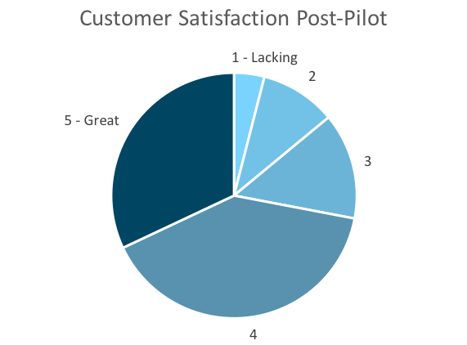
Customer Satisfaction: Pilot
Q. On a scale of 1-5, please rate your experience with the tablet overall.
This pie chart illustrates the results from the post-pilot survey.
72% of respondents indicated a customer satisfaction score of 4 or 5.
Notes:
First pie chart: Results from the post-pilot survey
Second pie chart: Results from the post-launch survey, after making changes
Satisfaction has gone up from 72% (4 and 5 rating) to 86% (4 and 5 rating)
Post-pilot data:
1 - Lacking 2 4%
2 5 10%
3 7 14%
4 20 40%
5 - Great 16 32%
Post-launch data:
1 - Lacking 1 2%
2 2 4%
3 4 8%
4 22 44%
5 - Great 21 42%

Slide 4
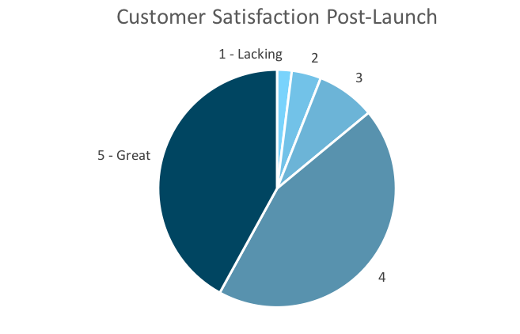
Customer Satisfaction: Launch
Q. On a scale of 1-5, please rate your experience with the tablet overall.
This pie chart illustrates the results from the post-launch survey.
86% of respondents indicated a customer satisfaction score of 4 or 5. This is a 14% increase.
Notes:
First pie chart: Results from the post-pilot survey
Second pie chart: Results from the post-launch survey, after making changes
Satisfaction has gone up from 72% (4 and 5 rating) to 86% (4 and 5 rating)
Post-pilot data:
1 - Lacking 2 4%
2 5 10%
3 7 14%
4 20 40%
5 - Great 16 32%
Post-launch data:
1 - Lacking 1 2%
2 2 4%
3 4 8%
4 22 44%
5 - Great 21 42%

Slide 5
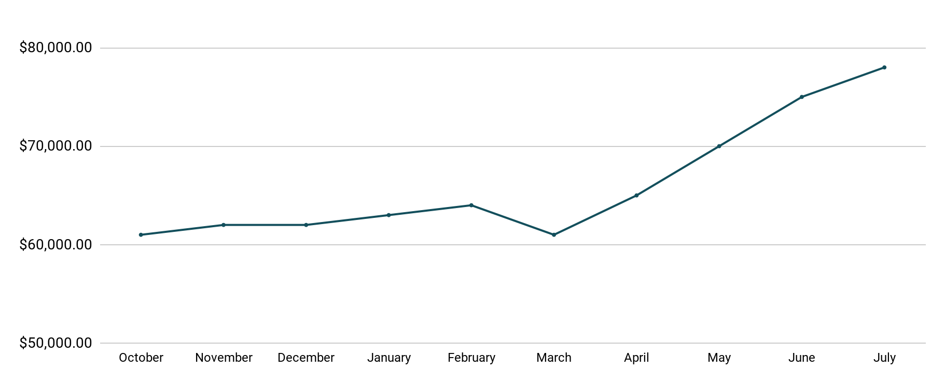
Revenue
Tablet Launch April 23
This is a chart of Sauce & Spoon revenue, showing that after tablet implementation, revenue increased.
July revenue was up to 20% over April’s monthly revenue.
Notes:
This is a chart of Sauce & Spoon revenue, showing that after tablet implementation, revenue increased. December revenue was up to 20% over September’s monthly revenue.
Sales data:
October
$61,000.00
November
$62,000.00
December
$62,000.00
January
$63,000.00
February
$64,000.00
March
$61,000.00
April
$65,000.00
May
$70,000.00
June
$75,000.00
July
$78,000.00

Slide 6
What Worked: Key Accomplishments
Decreased table turn time
Implementation of the tablets increased the average daily guest count by 10%.
Tablets also decreased wait time by 30 minutes.
Decreased food waste
Tablets identified who was receiving an incorrect order.
Kitchen staff has taken the initiative to correct orders and decrease food waste by 50%.
Increased customer satisfaction
After the pilot, customer satisfaction was at 72%.
Once we implemented improvements based on feedback, customer satisfaction increased to 86%.
Increased sales
Our monthly revenue has increased steadily since the tablet rollout, upwards of 20% since September/pre-rollout.
Tablets also helped boost revenue during the holiday season.

Slide 7
Next Steps: Looking Forward
Initiative | Action | Date
Implement tablets in more locations | Create new project plan for new location installation | Q2
Continue to track customer experience and satisfaction | Continue surveying/ gathering data through various means | Ongoing
Expand tablet features | Investigate new features like social media integration, reservations, videos, etc. | Q4

Slide 8
Appendix
Access all resources here.
Notes:
Insert link to your shared drive or a shared folder with all of the relevant project artifacts

